Slide 1

DEPARTMENT OF COMPUTER SCIENCE AND ENGINEERING
CLASSIFYING TOR TRAFFIC ENCRYPTED PAYLOAD
USING MACHINE LEARNING
GUIDED BY:
MR.G.SENTHILIVELAN
CSE-D BATCH NO:05
K.LAVANYA (211061101198)
K.RICHITHA(211061101224)
K.HARSHITHA(211061101234)

Slide 2
ABSTRACT
The rapid evolution of internet technologies has necessitated advanced methodologies for monitoring and classifying encrypted network traffic. This study introduces a robust framework utilizing Machine Learning (ML) to classify Tor traffic encrypted payloads, an essential step for enhancing cybersecurity measures. Utilizing a dataset featuring columns such as Source Port, Destination Port, Protocol, Flow Duration, various Inter-Arrival Times (IAT), and others, we apply three distinct ML models: Decision Tree, Logistic Regression, and XGBoost. Our objective is to accurately predict the nature of traffic ('label' as the target column), thereby distinguishing between benign and potentially malicious activities. The effectiveness of each model is evaluated based on their predictive accuracy and computational efficiency, offering insights into the optimal approaches for real-time encrypted traffic analysis. This research contributes to the development of more secure network environments by leveraging advanced data analytics in the realm of cyber security.

Slide 3
LITERATURE SURVEY
S.NO | YEAR | AUTHORS | TITLE | OUT COMES
1 | 2023 | N. Rust-Nguyen, S. Sharma, and M. Stamp | Darknet traffic classification and adversarial attacks using machine learning | Using the CIC-Darknet2020 dataset, our study finds that a Random Forest model outperforms other state-of-the-art techniques. To assess the robustness of our classifier, we simulate adversarial attack scenarios by obfuscating select application type classes.
2 | 2021 | P. Choorod and G. Weir | Tor traffic classification based on encrypted payload characteristics | We analyzed hex characters in encrypted payloads and achieved a significant differentiation rate of 94.53%. Our machine learning approach, based on encrypted payload features, attained an average classification accuracy of 95.65% across 8 application types.

Slide 4
S.NO | YEAR | AUTHORS | TITLE | OUT COMES
3 | 2020 | D. Sarkar, P. Vinod, and S. Y. Yerima | Detection of tor traffic using deep learning | This paper presents a deep neural network (DNN) based system for detecting and classifying encrypted Tor traffic, achieving 99.89% accuracy on the UNB-CIC Tor network dataset. For classifying Tor traffic types, the system attained 95.6% accuracy, 6.2% higher than previous work.
4 | 2019 | S. Rezaei and X. Liu | Deep learning for encrypted traffic classification: An overview | With the advancement of deep learning, researchers have achieved high accuracy in traffic classification. This article introduces a general framework for deep-learning-based traffic classification, detailing commonly used deep learning methods and their applications. It also explores open problems, challenges, and future opportunities in the field of traffic classification.

Slide 5
EXISTING SYSTEM
Current Tor traffic classification methods primarily rely on flow-based features, which can be unreliable due to asymmetric routing and the need for multiple packets for feature computation, causing processing delays.
These methods often fail to accurately differentiate between Tor and nonTor traffic. Existing systems do not effectively utilize encrypted payload data for classification, leading to inefficiencies in monitoring Tor traffic.
Our research addresses these limitations by focusing on single encrypted payload packets for efficient classification.

Slide 6
DISADVANTAGES
Existing systems face challenges in accurately classifying traffic because flow-based features can be disrupted by asymmetric routing paths.
The need for multiple packets to compute flow-based features causes delays and inefficiencies in real-time traffic processing.
Current methods struggle to accurately distinguish between Tor and nonTor traffic, leading to potential misclassifications.
These systems do not effectively leverage encrypted payload data, resulting in missed opportunities for more accurate traffic classification.
Due to their reliance on flow-based features, existing methods are less efficient in monitoring Tor traffic, particularly in high-speed network environments.

Slide 7
PROPOSED METHOD
The proposed system leverages Machine Learning (ML) techniques to classify encrypted Tor traffic payloads, enhancing cybersecurity by distinguishing between benign and malicious activities.
Utilizing a comprehensive dataset with features like Source Port, Destination Port, Protocol, Flow Duration, and Inter-Arrival Times (IAT), we implement three ML models: Decision Tree, Logistic Regression, and XGBoost.
Each model is assessed for predictive accuracy and computational efficiency, aiming to identify the optimal approach for real-time encrypted traffic analysis and thus contribute to more secure network environments.

Slide 8
ADVANTAGES
The system effectively identifies malicious activities within encrypted Tor traffic, bolstering overall network security.
It offers real-time traffic analysis, allowing for immediate detection and response to potential threats.
By employing Decision Tree, Logistic Regression, and XGBoost, the system ensures robust and adaptable classification capabilities.
Utilizing comprehensive features like Source Port, Destination Port, Protocol, Flow Duration, and IAT enhances the accuracy of traffic classification.
The evaluation of computational efficiency ensures the system can be implemented in real-world scenarios without significant performance overhead.

Slide 9
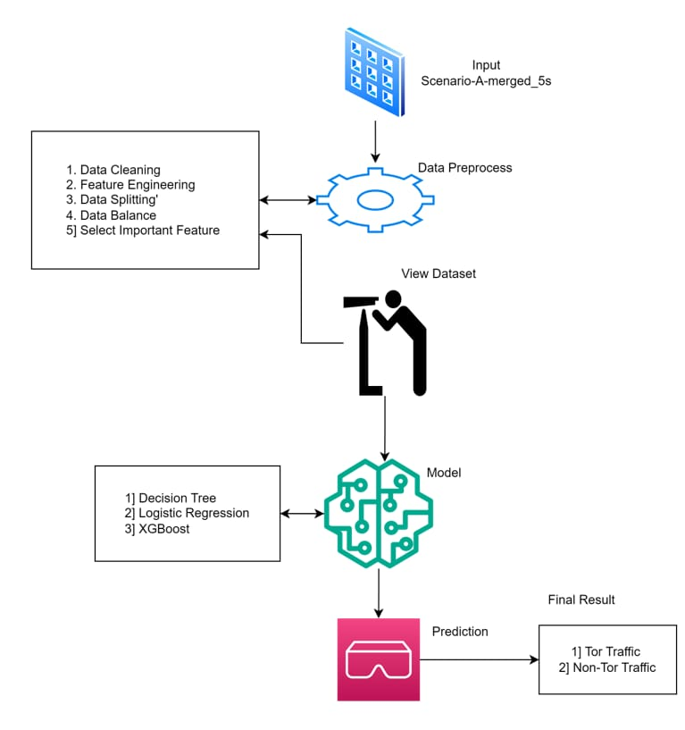
ARCHITECTURE OF PROPOSED SYSTEM

Slide 10




ARCHITECTURE OF PROPOSED SYSTEM
INPUT
SCENARIO-A-MERGED_5S
1.Data Cleaning: process of detecting and correcting (or removing) corrupt or inaccurate records from a record set, table, or database
DATA PREPROCESS
2.Feature Engineering: process of creating new features or transforming existing features to improve the performance
3.Data Splitting: process of dividing a dataset into distinct subsets to train, validate, and test a model.
1.Decision Tree: A decision tree is a flowchart-like structure used to make decisions or predictions.
4.Data Balance: the number of Positive and Negative labels is about equal.
MODEL
2.Logistic Regression: Another model used for classification, particularly useful for binary classification problems.
5.Select Important Feature: Process of choosing only relevant data and get rid of noise data
BACKUP DATA
3.XGBoost: A powerful machine learning library used for the XGBoost classifier.
PREDICTION
1]TOR TRAFFIC 2]NON-TOR TRAFFIC

Slide 11
MODULES
COMPONENTS:-
Data Collection and Preprocessing:
Dataset Features: The dataset includes features such as Source Port, Destination Port, Protocol, Flow Duration, and Inter-Arrival Times (IAT).
Feature Selection: The system uses Recursive Feature Elimination (RFE) to optimize the selection of relevant features for model training.
Data Encryption:
Advanced Encryption Standard (AES): This encryption algorithm is used to ensure the privacy of the data while it is being processed.
Machine Learning Models:
Decision Tree Classifier: A machine learning model used for classifying the encrypted Tor traffic.
Logistic Regression: Another model used for classification, particularly useful for binary classification problems.
XGBoost (Extreme Gradient Boosting) Classifier: A more advanced machine learning model known for its high performance in various classification tasks.
Model Evaluation:
Metrics: The models are evaluated based on predictive accuracy and computational efficiency.

Slide 12
CONNECTIONS:-
Feature Extraction and Selection: The raw data is processed to extract relevant features (Source Port, Destination Port, etc.). RFE is used to refine the selection of these features before they are fed into the machine learning models.
Data Encryption: The extracted features are encrypted using AES to maintain privacy before further processing.
Machine Learning Model Training: The encrypted and feature-selected data is then used to train the three different machine learning models: Decision Tree, Logistic Regression, and XGBoost.
Model Evaluation and Selection: The trained models are evaluated based on their performance metrics, and the best model is selected for real-time encrypted traffic classification.

Slide 13
Technology Stack:-
Data Encryption:
Advanced Encryption Standard (AES): A widely used encryption algorithm to secure data.
Machine Learning:
Scikit-Learn: Likely used for implementing the Decision Tree and Logistic Regression models.
XGBoost: A powerful machine learning library used for the XGBoost classifier.
Data Handling and Processing:
Python: Most likely used for data preprocessing, feature selection, and machine learning model implementation.
Pandas/Numpy: Common libraries for handling datasets and performing numerical operations.
Evaluation and Performance Metrics:
Accuracy and Computational Efficiency: Standard metrics used to evaluate and compare the performance of the machine learning models.

Slide 14
REFERENCES
[1] C. Johnson, B. Khadka, E. Ruiz, J. Halladay, T. Doleck, and R. B. Basnet, ‘‘Application of deep learning on the characterization of tor traffic using time based features,’’ J. Internet Serv. Inf. Secur., vol. 11, no. 1, pp. 44–63, 2021.
[2] O. Salman, I. H. Elhajj, A. Kayssi, and A. Chehab, ‘‘A review on machine learning-based approaches for Internet traffic classification,’’ Ann. Telecommun., vol. 75, nos. 11–12, pp. 673 710, Dec. 2020.
[3] J. Barker, P. Hannay, and P. Szewczyk, ‘‘Using traffic analysis to identify the second generation onion router,’’ in Proc. IFIP 9th Int. Conf. Embedded Ubiquitous Comput., Melbourne, VIC, Australia, Oct. 2011, pp. 72–78.
[4] S. Rezaei and X. Liu, ‘‘Deep learning for encrypted traffic classification: An overview,’’ IEEE Commun. Mag., vol. 57, no. 5, pp. 76–81, May 2019.
[5] J. Katz and Y. Lindell, Introduction to Modern Cryptography, 2nd ed. New York, NY, USA: CRC Press, 2020.

Slide 15
[6] P. Choorod and G. Weir, ‘‘Tor traffic classification based on encrypted payload characteristics,’’ in Proc. Nat. Comput. Colleges Conf. (NCCC), Mar. 2021, pp. 1–6.
[7] A. H. Lashkari, G. D. Gil, M. S. I. Mamun, and A. A. Ghorbani, ‘‘Characterization of Tor traffic using time-based features,’’ in Proc. 3rd Int. Conf. Inf. Syst. Secur. Privacy (ICISSP), Porto, Portugal, Feb. 2017, pp. 253–262.
[8] A. Cuzzocrea, F. Martinelli, F. Mercaldo, and G. Vercelli, ‘‘Tor traffic analysis and detection via machine learning techniques,’’ in Proc. IEEE Int. Conf. Big Data (Big Data), Boston, MA, USA, Dec. 2017, pp. 4474–4480.
[9] D. Sarkar, P. Vinod, and S. Y. Yerima, ‘‘Detection of tor traffic using deep learning,’’ in Proc. IEEE/ACS 17th Int. Conf. Comput. Syst. Appl. (AICCSA), Nov. 2020, pp. 1–8.
[10] N. Rust-Nguyen, S. Sharma, and M. Stamp, ‘‘Darknet traffic classification and adversarial attacks using machine learning,’’ Comput. Secur., vol. 127, Apr. 2023, Art. no. 103098.

